Slide 1
SPS Research Night
Hirschmann/Neilsen Research Group

Slide 2
Who can join our group?
Anyone can join! No prior experience or class prerequisites are needed.

Slide 3
What does our group do?
We study the effects of general relativity through numerical simulations.
Our group works on a larger codebase called Dendro-GR that simulates binary black hole mergers to create patterns of gravitational waves.

Slide 4
When do we meet?
Theory Group Meeting:
Tuesdays 3:00 – 4:00 PM
This meeting is in ESC N209
Relativity Group Meeting:
Thursday 2:00 – 3:30 PM
Working Group Meetings:
Tuesdays 2:00 – 3:00 PM
Tuesdays 4:00 – 5:00 PM
Thursdays 1:00 – 2:00 PM
Thursdays 3:00 – 4:00 PM
All other meetings are in ESC N216

Slide 5
Where do we meet?
ESC N216
The door has a lock but if you show up to our meetings regularly, we’ll give you the code!

Slide 6
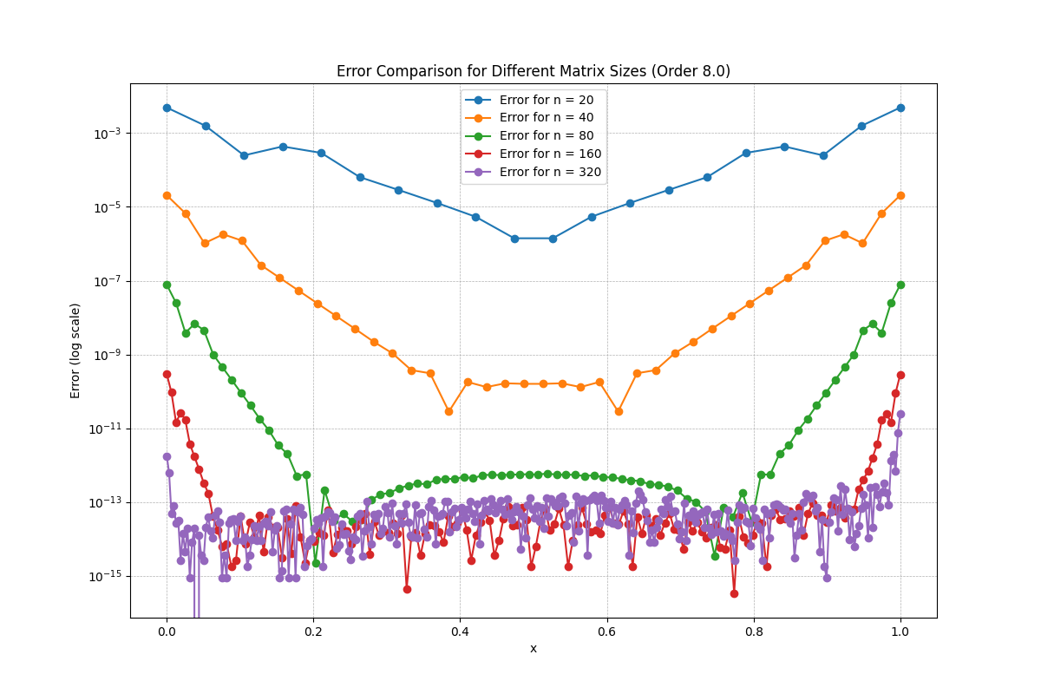
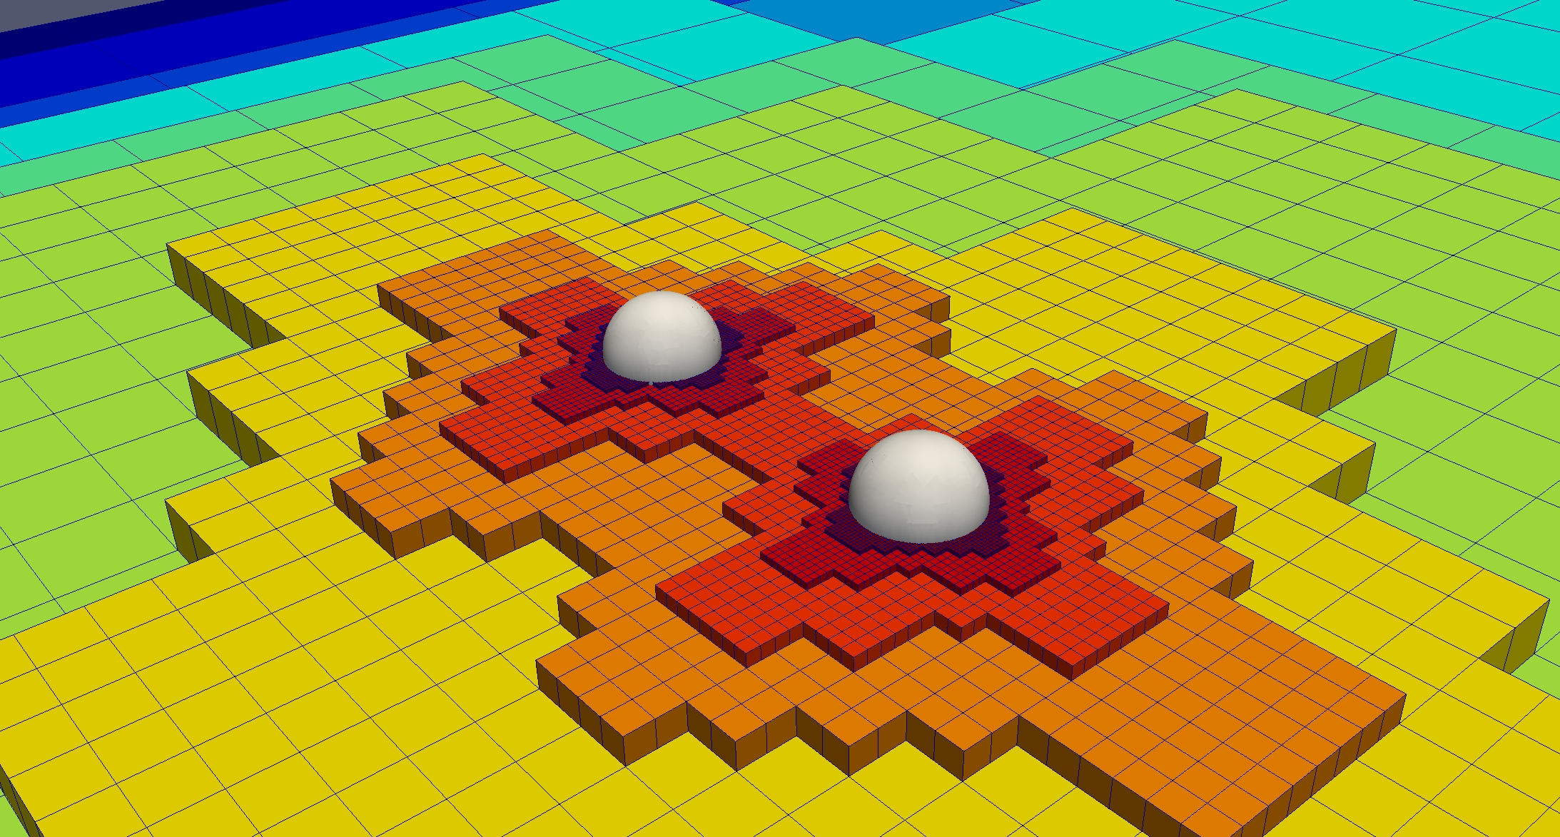
Cool Results! Part 1

Slide 7
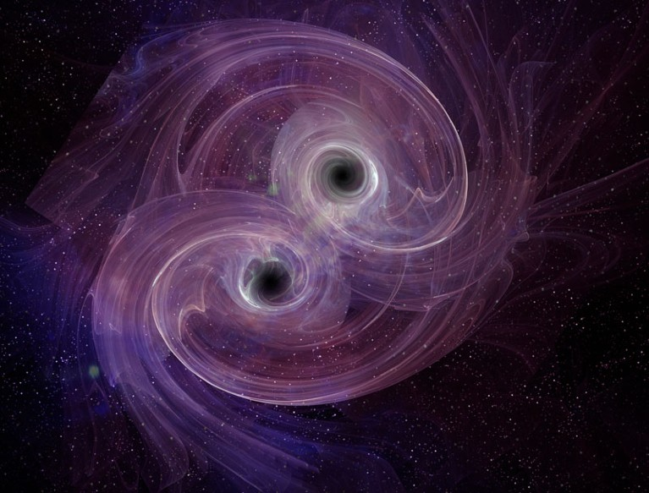
Cool Results! Part 2

